Slide 2
HOSTING ORGANIZATION
Translating from English, Framtidståget means “the Train of Future” which in line with our name, Framtidståget mission is to help people get on the right track for a better future. Framtidståget’s moto is giving people a second and, when needed, a third chance. In our work we aim to contribute to building a more cooperative and inclusive society.
The main areas of work are:
∙Working with young people in difficult situations through therapy methods;
∙Working with families who struggle with violence in their families, to help them build more peaceful and fulfilling relationships;
∙Integration work and working with foster families hosting minor unaccompanied newly arrived young people;
∙International youth projects.
The main target groups are children and young people, especially, youth at risk and young people with fewer opportunities.
/framtidstaget
/framtidstaget
www.framtidstaget.se

Slide 3
ABOUT THE PROJECT
The idea of the project is strongly related to the Swedish word Lagom, which means “enough, sufficient, adequate, just right”. It also means “in moderation”, “in balance”, “perfect-simple” and “suitable” in the matter of amounts.
Balancing stress, clarify personal goals and building up more attentiveness of ourselves is a necessary issue in everybody’s daily life. Lagom is for example a Swedish way of dealing with life. This project wants to offer a place surrounded by nature to share, to experience and to collect ways of dealing with stressful moments and issues, as well as enjoying the moments, while being “offline” to get to know ourselves and our interaction with the environment even better. Furthermore, this project aims to strengthen social skills and key competencies during a high level of participation and various outdoor activities (f.ex. hiking, cooperative games).
Aims of the project:
- To promote intercultural dialogue, exchange knowledge and share experiences about reducing, handling and dealing with stressful moments,
- To connect people from different countries, to create attentiveness for themselves and encourage them to start thinking more critically about the interaction between the environment, society and their own impact.
- Supporting individuals in acquiring and developing basic skills and key competencies through physically, psychologically and social challenges, which will create more sense of responsibility and mindfulness in dealing with people, society and environment.
- Giving priority to actions that help address diversity and promote ownership of shared values such as equality, including gender equality, non-discrimination, and social inclusion.

Slide 4
PROFILE OF PARTICIPANTS
The project will gather 30 people, 5 from each participating country (including one team leader).
Participating countries and organizations:
Portugal - Associação Inspira
Italy - Associazione Attiva-Mente
Serbia - Odred izvidjaca "10. Oktobar"
Slovakia - Youthfully Yours
Romania - GEYC
PARTICIPANTS’ ROLE
The main idea of Erasmus+ youth exchanges is that they are created for young people and by young people. That is why we expect that everyone will be an organiser and a participant at the same time!
Every participant will get an opportunity, among other, to plan and facilitate the project’s activities, organise food and logistics of the project and make sure that we have a great week together!
So, feel free to take initiative, this is a great chance to develop and learn!

Slide 5
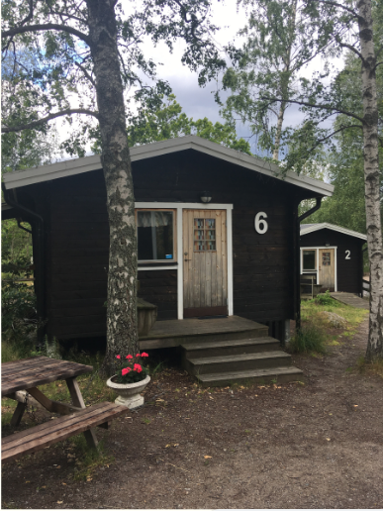
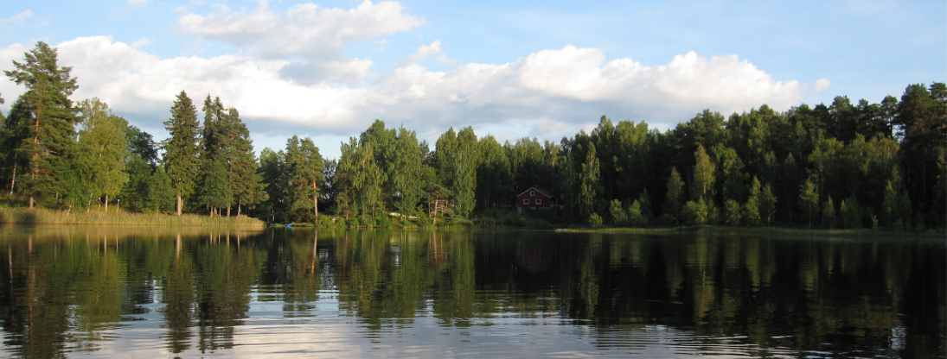
Venue, food and accommodation
The project will take place in Hellasgården, a resort located on a lake within 20 minutes from Stockholm’s centre. Participants will be accommodated in cottages where they will stay in rooms of 4 with people of the same gender.
Please keep in mind that the cottages are small when packing, and travel light and avoid bringing big suitcases since it will be rather difficult to store them.
The venue offers possibilities for many activities such as swimming in the lake, as well as other activities like sauna and hiking (Some are free, some are not).

Slide 6
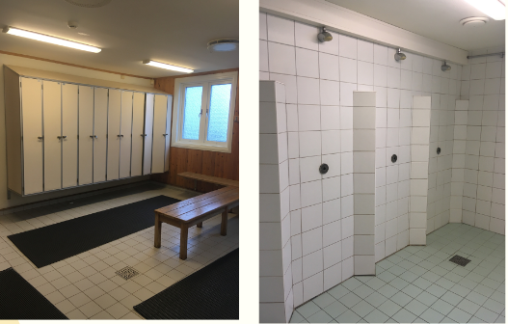
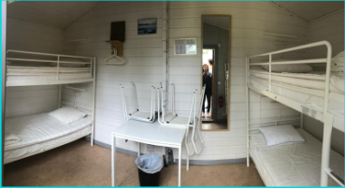
Venue, food and accommodation
There are two shared bathrooms and showers facilities next to the rooms for the two genders. A common hairdryer is available in the bathrooms. One towel and sheets are including for each participants. Please keep in mind that bathrooms and the toilets are outside of your rooms and you will have to walk outside (bring flip-flops!)
We will prepare our meals together (breakfast, lunch, dinner and two coffee breaks). When planning meals special needs and allergies will be taken into account. For environmental reasons, we will limit the consumption of animal products during this project and will not cook dishes containing beef.
You can find more information about Hellasgården in English on their website: https://hellasgarden.se/en.

Slide 7
MEASURES CONNECTED TO COVID -19
Before the project:
Everyone arriving to Sweden from outside the country is in need of a negative PCR test to enter the country. That’s why everyone is expected to bring a negative COVID -19 test to enter the country, which is not older than 48 hours before the arrival. Detailed information about the test requirement can be found here.
We encourage every participant to minimize your social contacts two weeks before the project.
While arriving to the project, please avoid close contact to people and wear masks in common transports, to minimize the risk of getting infected on the way.
We expect every participant to bring their own masks. We recommend FFP2, if that is possible for you.
During the project:
Everyone arriving to Sweden from abroad is recommended to stay at home during 7 days. If the recommendation is still valid in July we will have to stay in the venue area and be able to make trips to the city only on the last day of the project.
We will make sure that the windows are always open in the common closed spaces.
Most of our planned activities will take place outside and we are planning activities that do not include close physical contact. Be aware of bringing enough clothes to stay outside for a longer time :)
We will wear masks during activities, if held indoors or require close contact.
We will divide the group in two while having lunch and most likely eat outside to keep enough distances.
We will make sure of enough disinfectants in common rooms and all rooms will be cleaned everyday.
We are planning an organised day in Stockholm on a weekday when there are less people outside in the city to minimize the risk of infection.
Participants showing cold symptoms will be placed in a separate room and will be tested for covid-19.
After the project:
On your way home, again avoid close contact to people and wear masks in common transports, to minimize your risk of getting infected on your way home.
If you feel sick and have gotten any symptoms of Covid-19 after the project, please inform us immediately, so we can inform other participants.

Slide 8
AFTER YOU HAVE BEEN SELECTED
After you have received a confirmation from your sending organisation that you have been selected to be a participant in the project, you will need to do the following steps:
Contact other participants and find a good travel option to Stockholm, which is the cheapest and the most convenient. Please, consider only fully-refundable tickets for your travel.
Send your tickets choice to Andreea at andreea.f@framtidstaget.se and Yulia at yulia.kh@framtidstaget.se for confirmation. Please, do not purchase tickets before you get our confirmation!
Fill in the participation form.
Join the Facebook group.
Please, do all the above steps before the 11th of May.
Meet your team members and organisers online to prepare for the project, pack your bag, take a PCR-test and arrive to Stockholm!

Slide 9
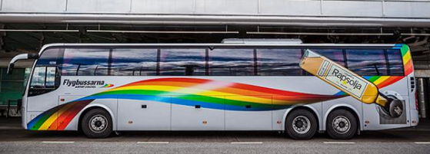
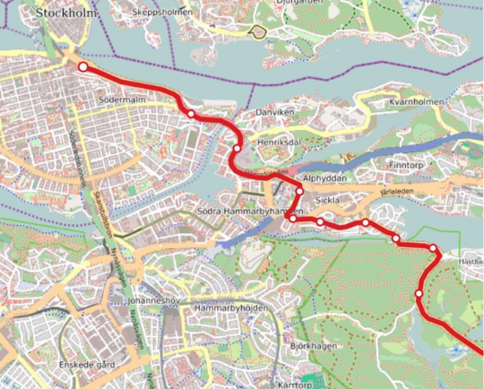
ARRIVAL TO STOCKHOLM
First, just outside of the airport you will take the Airport Shuttle bus (45 mins from Arlanda and 80 from Skavsta) to Stockholm’s central station (aka T-Centralen). The name of the company is Flygbussarna and you can check the schedules on their website https://www.flygbussarna.se/en.
As for the tickets, we will send them to you on email and you can either print them, or just scan them from your phone once at the bus. Upon your arrival to Stockholm, you will land at either Arlanda or Skavsta Airport. From there, your journey includes 2 buses and one short metro ride.
Once at the bus station, you will find a representative from our organisation holding a sign with the project logo! He or She will help you to board the bus to Hellasgården where the rest of us will be waiting.
The bus will take 17 mins to reach Hellasgården.
Please remember to press the red stop button inside the bus once Hellasgården shows on the screen, otherwise the bus driver won’t stop. In case you think you might have any difficulties, you may ask the bus driver to stop at Hellasgården earlier, they will speak English!

Slide 10
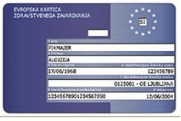
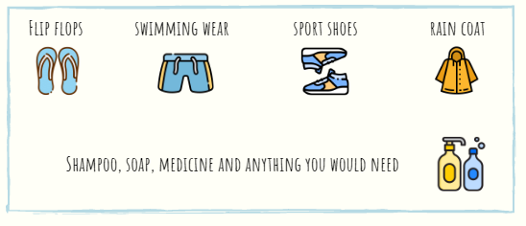
INSURANCE
European citizens are required to bring their blue EU health insurance card. Otherwise we recommend You to have a travel insurance valid in Sweden during the stay.
Please note that insurances are not covered by the project and they will be on your own cost.
DON’T FORGET
Please, take a few fabric masks (minimum 7, one for each) or a pack of medical masks with you (FFP2 masks, if you have are also great)!

Slide 11
Travel costs and reimbursement
In order to receive travel costs reimbursement, you will have to:
Gather all the online receipts (or flight tickets) in a ".pdf" format and scan/take a clear picture on the white background of the offline receipts and boarding passes. Please, note that it is obligatory to have both receipts and boarding passes (a document you receive when you check in for a flight) to be able to receive reimbursement.
All receipts should contain information about destination, your name and price of the ticket.
Name the receipts and boarding passes exactly as what they served for. For ex: “Flight Ticket Stockholm - Paris" and "BoardingPass Stockholm - Paris"
Send the electronic copies of receipts to Andreea (andreea.f@framtidstaget.se) and Yulia (yuliya.kh@framtidstaget.se) latest within one week after the project.
You do not need to submit the original paper receipts to us as long as you made a clear and high quality scan of your receipts.
Reimbursement will be done in EUR, regardless of the currency indicated on the ticket and receipt/invoice. Any tickets purchased in a local currency other than EUR, will then be converted and calculated according to the exchange rate for October 2019 (month when the grant for the project was received).
Participants will receive the travel reimbursement via bank transfer to their sending organizations within 3 months after the end of the project upon receipt of all travel documentation from all the participants.
Please note that to receive a reimbursement you have to fully participate on the project, for the exception of emergency cases with proof (e.g. medical certificate, canceled flight).

Slide 12
Travel costs and reimbursement
Maximum amount of travel and visa costs reimbursement per country:
Portugal | 360 EUR
Italy | 360 EUR
Serbia | 275 EUR
Slovakia | 275 EUR
Romania | 275 EUR
Please note that in order to enter Sweden you will have to present a negative COVID -19 - test that is taken no later than 48 hours before arrival to Sweden. The following tests are approved: Antigen tests, PCR tests, LAMP tests and TMA tests. You can find a more detailed information on what should be included in a test certificate to enter Sweden here.
Please, note that you you will be able to use the travel costs budget to cover the cost of a Covid-19 test within the maximum reimbursement amount written above.

Slide 13
LINKS AND CONTACTS
If you have any questions about the project, travel in Stockholm or any emergencies, please contact:
Yulia
+46 - 76-223 21 87
yuliya.kh@framtidstaget.se
Andreea
andreea.f@framtidstaget.se
Nicole
nicole.vogele@gmx.de
SEE YOU SOON!

